Slide 1
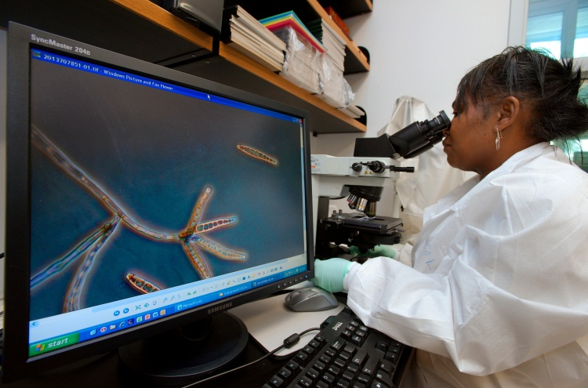
CDC Webinar: Update on the Multistate Outbreak of Fungal Meningitis and Other Infections
Thursday, December 20, 2012
Centers for Disease Control and Prevention
National Center for Emerging and Zoonotic Infectious Diseases

Slide 2
Agenda
Overview of new CDC Health Update
Tom Chiller, MD, MPH (CDC)
Presentation of clinical case findings and strategies for treatment
Anu Malani, MD (St. Joseph’s Mercy Medical Center)
Michael Kasotakis, MD (St. Joseph’s Mercy Medical Center)
Q & A Session
***Please mute your phone during the presentations***

Slide 3
CDC Health Update
New data provides evidence that a substantial proportion of patients have developed localized infections following exposure to contaminated injections
Signs and symptoms of these spinal/paraspinal infections can be subtle and difficult to distinguish from the patient’s baseline chronic pain, clinicians should consider obtaining an MRI for patients with persistent but baseline symptoms
This decision should be made on a case-by-case basis after a discussion between the clinician and patient and taking into account the patient’s history regarding past and current symptoms
More information online: http://www.cdc.gov/hai/outbreaks/meningitis.html

Slide 4
Fungal Infections Associated with Contaminated Methylprednisolone Injections — Spinal/Paraspinal Case Series
Anurag Malani, M.D.
Medical Director, Antimicrobial Stewardship Program
Associate Medical Director, Infection Prevention & Control
St. Joseph Mercy Health System – Ann Arbor
Michael Kasotakis, M.D.
Neuroradiology
St. Joseph Mercy Health System – Ann Arbor
December 20, 2012
4
Notes:
I want to highlight 5 cases that illustrate the various presentations we are now seeing:
Case 1 is Parameningeal infection
Case 2 is Epidural abscess
Case 3 is Epidural abscess with minimal symptoms
Case 4 is Osteomyelitis and Discitis
Case 5 is Sacroiliac osteomyelitis

Slide 5
Contents
Case 1: Parameningeal infection
Case 2: Epidural abscess
Case 3: Epidural abscess with minimal symptoms
Case 4: Osteomyelitis and discitis
Case 5: Sacroiliac osteomyelitis
5
Notes:
I want to highlight 5 cases that illustrate the various presentations we are now seeing:
Case 1 is Parameningeal infection
Case 2 is Epidural abscess
Case 3 is Epidural abscess with minimal symptoms
Case 4 is Osteomyelitis and Discitis
Case 5 is Sacroiliac osteomyelitis

Slide 6
Case 1: Parameningeal Infection
Notes:
I will start with a case of parameningeal infection

Slide 7
Case 1: Parameningeal Infection
Diagnosis:
Potential complication of fungal meningitis, despite treatment
MRI of epidural injection site indicated in meningitis
MRI results hard to interpret after surgery; may lag behind clinical improvement
Treatment:
Prolonged amphotericin course in some arachnoiditis cases
7
Notes:
Here are the key points of this case:
In terms of Diagnosis:
-Parameningeal infection is a potential complication of fungal meningitis, and may occur despite medical therapy.
-An MRI of the epidural injection site is indicated in patients presenting with fungal meningitis, and probably should be completed 2-3 weeks after presentation. . And, MRI findings can be difficult to interpret in post-operative setting, and may lag behind clinical improvement.
In terms of Treatment:
A Prolonged course of amphotericin (ambisome) may be necessary in some cases of arachnoiditis.

Slide 8
Case 1: Parameningeal Infection Hospitalization 1
ID: 72 y/o female
Injection type: L3-L4 epidural
Chief complaint: 1 week of headache, neck stiffness, chills, and fatigue 15 days after injection
Lumbar puncture: confirmed meningitis
Medical treatment:
Inpatient: voriconazole + amphotericin for 5 days
Discharge: 26 days after injection
Symptoms: Improved
Outpatient treatment: oral voriconazole
WBC: 549 cells/µl | Glucose: 45 mg/100mL
PCR: negative for fungal DNA | Protein: 53 mg/100mL
8
Notes:
Case 1 is a 72 y/o female with a history of a contaminated L3-L4 epidural injection.
Her chief complaint was 1 week of headache, neck stiffness, chills, and fatigue 15 days after injection.
Her lumbar puncture showed 549 white blood cells, and confirmed a diagnosis of meningitis, though the PCR was negative for fungal DNA.
Medical treatment was initiated with voriconazole combined with liposomal amphotericin for 5 days.
Her clinical symptoms improved and she was discharged 26 days after her injection and continued on oral voriconazole as an outpatient.

Slide 9
Case 1: Parameningeal Infection Hospitalization 2
Chief complaint: back pain, lower extremity weakness 36 days after injection
Magnetic Resonance Imaging (MRI):
Enhancement projecting intradural at L3 level
9
Notes:
Unfortunately, this patient returned to the hospital 36 days after her injection with a chief complaint of back pain and lower extremity weakness.
I will ask Dr. Mike Kasotakis, a Neuroradiologist at our hospital, to interpret her MRI findings

Slide 10
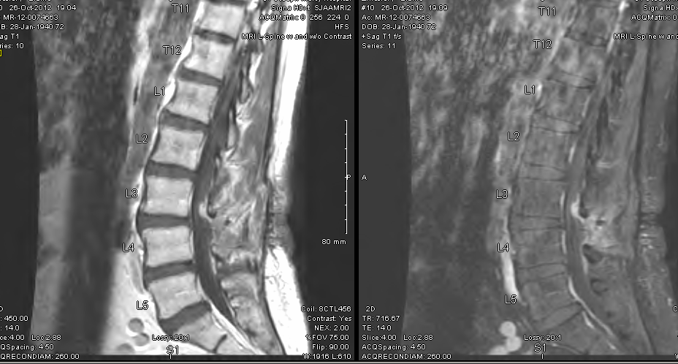
Case 1: MRI 36 Days after Injection
Enhancement in dorsal thecal sac
10
Photo credit: St. Joseph Mercy Health Systems
Notes:
(comments from Mike Kasotakis)

Slide 11
Case 1: MRI 36 Days after Injection
Enhancement and clumping of nerve roots.
Photo credit: St. Joseph Mercy Health Systems
11
Notes:
(comments from Mike Kasotakis)

Slide 12
Case 1: Parameningeal Infection Hospitalization 2
Chief complaint: back pain, lower extremity weakness 36 days after injection
Magnetic Resonance Imaging (MRI):
Enhancement projecting intradural at L3 level
Operative treatment:
Procedure: evacuation of epidural abscess, L3 laminectomy
Intraoperative Findings:
Phlegmon-like material adherent to clumping nerve roots
Small amount of pus
12
Notes:
Thanks Mike,
Given these MRI findings, our Neurosurgeons performed an evacuation of the epidural abscess and L3 laminectomy. Intraoperatively they described Phlegmon-like material adherent to clumping nerve roots and a small amount of pus

Slide 13
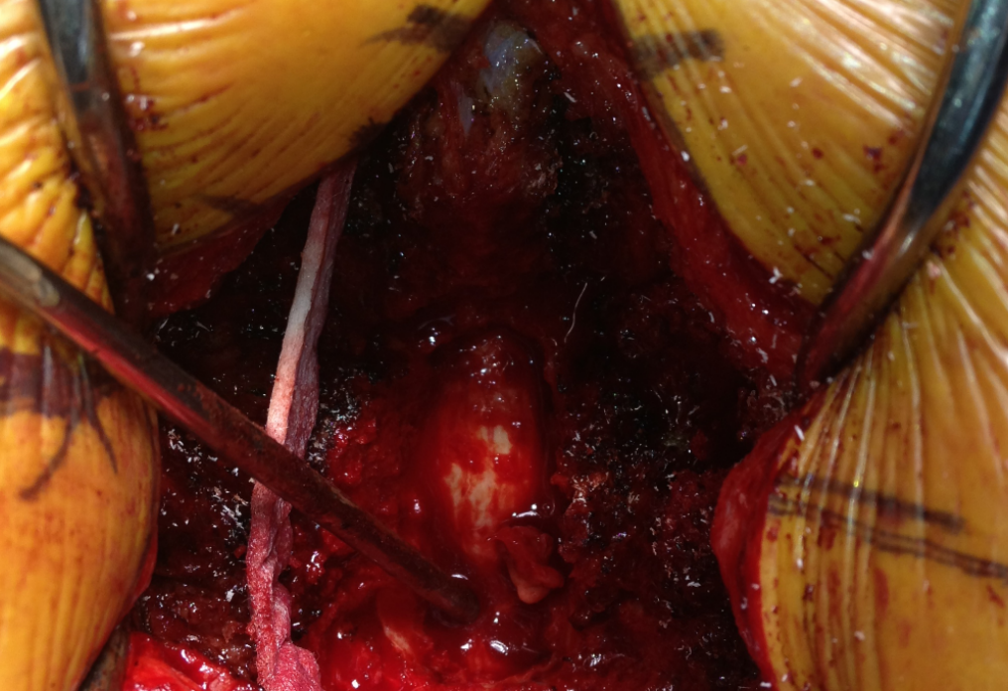
Case 1: Operative Findings
Thecal Sac with phlegmon
Photo credit: St. Joseph Mercy Health Systems
13
Notes:
This is an intraoperative image from a patient with a similar presentation, showing a thecal sac with visible phlegmon

Slide 14
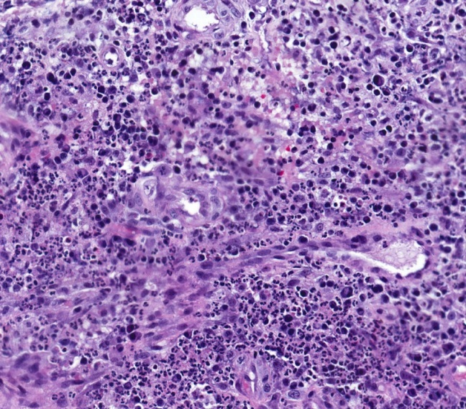
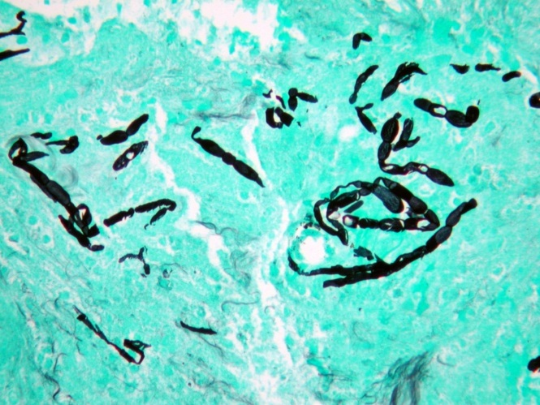
Case 1: Operative Pathology
Source: Intradural abscess
Stain: Hematoxylin and eosin (H+E)
Findings: purulent inflammation
Source: Intradural abscess
Stain: Gomori methenamine silver (GMS)
Findings: fungal hyphae
Photo credit: St. Joseph Mercy Health Systems
14
Notes:
Pathology from the intradural abscess showed purulent inflammation on H+E stain,
and fungal hyphae on GMS stain

Slide 15
Case 1: Parameningeal Infection Hospitalization 2
Medical treatment:
Inpatient: voriconazole + amphotericin for 5 weeks
MRI: 62 days after injection
Stable arachnoiditis with intradural involvement
Postoperative changes/enhancement at laminectomy site
Discharge: 71 days after injection
Symptoms: improved
Outpatient Treatment: oral voriconazole
15
Notes:
Given these operative and pathology findings,
The patient was re-started on voriconazole and lipsomal amphotericin, and continued dual therapy for 5 weeks.
She had a follow-up MRI 62 days after injection which showed stable arachnoiditis with intradural involvement, and postoperative changes/enhancement at laminectomy site
At 71 days after injection, her symptoms had improved sufficiently for discharge, and she is continuing treatment on oral voriconazole.

Slide 16
Case 1: Parameningeal Infection — Summary
Diagnosis:
Potential complication of fungal meningitis, despite treatment
MRI of epidural injection site indicated in meningitis
MRI results hard to interpret after surgery; may lag behind clinical improvement
Treatment:
Prolonged amphotericin course in some arachnoiditis cases
16
Notes:
To summarize the key points of this case:
Remember that
In terms of Diagnosis:
-Parameningeal infection is a potential complication of fungal meningitis, and may occur despite medical therapy.
-An MRI of the epidural injection site is indicated in patients presenting with fungal meningitis, and probably should be completed 2-3 weeks after presentation. . And, MRI findings can be difficult to interpret in post-operative setting, and may lag behind clinical improvement.
In terms of Treatment:
A Prolonged course of amphotericin (ambisome) may be necessary in some cases of arachnoiditis.

Slide 17
Case 2: Epidural Abscess
Notes:
The next case I will discuss is epidural abscess

Slide 18
Case 2: Epidural Abscess
Diagnosis:
Potential rapid onset weeks after contaminated injection
Low MRI threshold in patients with persistent, worse, or new symptoms
Treatment:
Neurosurgical consultation critical
Optimal treatment duration unknown
18
Notes:
The key Diagnostic points are that:
-Epidural abscess can develop many weeks after a contaminated methylprednisolone injection
-therefore you should maintain a low threshold for ordering an MRI in patients with persistent, worse, or new symptoms.
In terms of Treatment:
-Neurosurgical consultation is critical when evaluating and treating epidural and parspinal abscesses, and
-Optimal treatment duration (and selection) for epidural abscess is unknown

Slide 19
Case 2: Epidural Abscess
ID: 47 y/o male
Injection type: C6-C7 epidural
Chief complaint: headache, confusion, malaise, neck pain and spasms increasing since injection
Lumbar puncture:
3 unremarkable studies, last 30 days after injection
MRI:
3 unremarkable cervical studies, last 31 days after injection
4th MRI 42 days after injection showed epidural abscess/phlegmon
19
Notes:
Case 2 is a 47 year-old male who received a contaminated C6-C7 epidural injection
He presented repeatedly after his injection with a chief complaint of headache, confusion, malaise, neck pain and spasms
During the 30 days after his injection, he had 3 unremarkable lumbar punctures,
And 3 unremarkable cervical MRI’s. A 4th MRI was ordered 42 days after his injection, which Mike will discuss

Slide 20
Case 2: MRI- T1 Weighted
31 Days after Injection
42 Days after Injection
C5-T1 phlegmon/epidural abscess
Photo credit: St. Joseph Mercy Health Systems
20
Notes:
(Mike’s comments)

Slide 21
Case 2: MRI- T2 Weighted, Fat Suppressed
31 Days after Injection
42 Days after Injection
C5-T1 phlegmon/epidural abscess
21
Notes:
(Mike’s comments)

Slide 22
Case 2: Epidural Abscess
Operative treatment:
Procedure: evacuation of epidural abscess, C5-C7 laminectomy
Intraoperative findings: abscess and pus
22
Notes:
Given these MRI findings, our Neurosurgeons performed an evacuation of the epidural abscess and C5-C7 laminectomy. Abscess and pus were visualized intraoperatively.

Slide 23
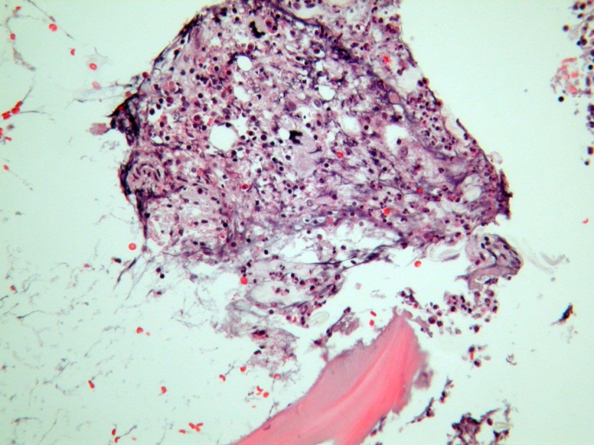
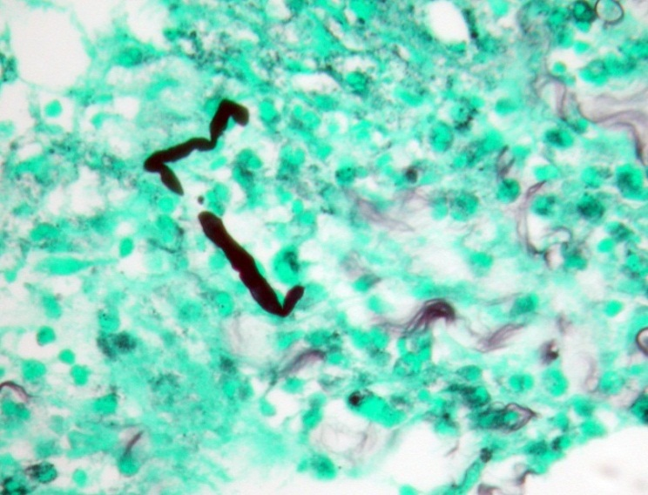
Case 2: Operative Pathology
Source: Epidural abscess
Stain: H+E
Findings: acute inflammation next to bony spicule
Source: Epidural abscess
Stain: GMS
Findings: Rare fungal hyphae
Photo credit: St. Joseph Mercy Health Systems
23
Notes:
Pathology from the epidural abscess showed acute inflammation next to a bony spicule on H+E stain (osteomyelitis)
and rare fungal hyphae on GMS stain.

Slide 24
Case 2: Epidural Abscess
Operative treatment:
Procedure: evacuation of epidural abscess, C5-C7 laminectomy
Intraoperative Findings: abscess and pus
Medical treatment:
Inpatient: voriconazole + amphotericin for 10 days
Discharge: 57 days after injection
Symptoms: improved
Outpatient treatment: oral voriconazole
24
Notes:
The patient was then medically treated with voriconazole and liposomal amphotericin for 10 days.
His symptoms improved and he was discharged 57 days after his injection and continues on oral voriconazole treatment.

Slide 25
Case 2: Epidural Abscess — Summary
Diagnosis:
Potential rapid onset weeks after contaminated injection
Low MRI threshold in patients with persistent, worse, or new symptoms
Treatment:
Neurosurgical consultation critical
Optimal treatment duration unknown
25
Notes:
To summarize, the key Diagnostic points are that:
-Epidural abscess can develop many weeks after a contaminated methylprednisolone injection
-therefore you should maintain a low threshold for ordering an MRI in patients with persistent, worse, or new symptoms.
In terms of Treatment:
-Neurosurgical consultation is critical when evaluating and treating epidural and parspinal abscesses, and
-Optimal treatment duration (and selection) for epidural abscess is unknown

Slide 26
Case 3: Epidural abscess with minimal symptoms
Notes:
Now I will present Case 3: epidural abscess with minimal symptoms

Slide 27
Case 3: Epidural Abscess with Minimal Symptoms
Diagnosis:
Patients with minimal or baseline symptoms may harbor epidural infections
Low MRI threshold
Operative findings may not correlate with microbiology or pathology results
27
Notes:
The key points in this case:
-First, patients with minimal or baseline symptoms may harbor epidural/paraspinal infections
-therefore, you should Maintain a low threshold for ordering an MRI in these patients
-Finally, Operative findings may not always correlate with microbiology or pathology results

Slide 28
Case 3: Epidural Abscess with Minimal Symptoms
ID: 43 y/o female
Injection type: L3-L4, L4-L5 epidural 34 days apart
Chief complaint: Lower back pain similar to baseline (rated 3/10)
Lumbar puncture: 12 days after last injection
WBC 1 cell/µl
MRI: 41 days after last injection
Neuroforaminal enhancement L4-L5
Enhancement at disc space margin
28
Notes:
Case 3 is a 43 year old female who received contaminated L3-L4 and L4-L5 epidural injections 34 days apart.
She presented to her doctor complaining reported lower back pain similar to her baseline, rated 3/10
She had a lumbar puncture 12 days after her injection, which had a white blood cell count of 1, not consistent with meningitis.
she underwent a lumbar MRI 41 days after her last injection. Mike will go over her MRI.

Slide 29
Case 3: MRI 41 Days after Last Injection
Neuroforaminal enhancement L4-L5
Enhancement at disc space margin
Foraminal fat effaced
Photo credit: St. Joseph Mercy Health Systems
29
Notes:
(mike to discuss)

Slide 30
Case 3: Epidural Abscess with Minimal Symptoms
Operative treatment: 44 days after last injection
Procedure: right L4-L5 laminectomy, medial facetectomy with foraminotomy of L4 root
Intraoperative findings: no abscess or pus
Anatomic Pathology: L4-L5 epidural fungal abscess
30
Notes:
Given these MRI findings, our Neurosurgeons performed a right L4-L5 laminectomy, and medial facetectomy with foraminotomy of the L4 root.
No abscess or pus was seen intraoperatively,
However, anatomic pathology showed an L4-L5 epidural fungal abscess

Slide 31
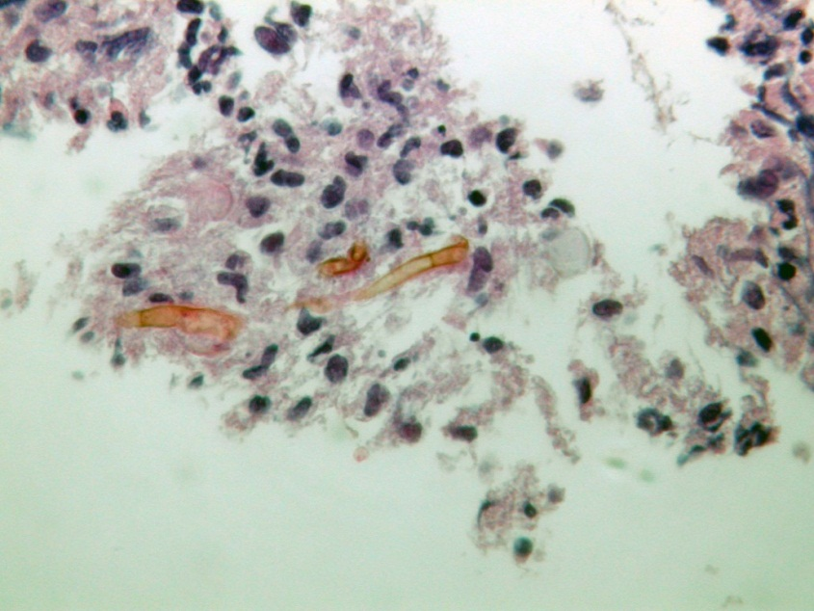
Case 3: Operative Pathology
Source: Paraspinal abscess
Stain: H+E
Findings: Acute inflammation with pigmented septate hyphae fragments
Photo credit: St. Joseph Mercy Health Systems
31
Notes:
Pathology from the paraspinal abscess shows Acute inflammation with pigmented septate hyphae fragments

Slide 32
Case 3: Epidural Abscess with Minimal Symptoms
Operative treatment: 44 days after last injection
Procedure: right L4-L5 laminectomy, medial facetectomy with foraminotomy of L4 root
Intraoperative findings: no abscess or pus
Anatomic Pathology: L4-L5 epidural fungal abscess
Medical treatment:
Inpatient: voriconazole + amphotericin
Discharge: 52 days after last injection
Symptoms: improved
Outpatient treatment: oral voriconazole
32
Notes:
The patient was medically treated with voriconazole and lipsomal amphotericin.
And she symptomatically improved by 52 days after her injection. She was discharged on oral voriconazole.

Slide 33
Case 3: Epidural Abscess with Minimal Symptoms — Summary
Diagnosis:
Patients with minimal or baseline symptoms may harbor epidural infections
Low MRI threshold
Operative findings may not correlate with microbiology or pathology results
33
Notes:
To summarize:
-Patients with minimal or baseline symptoms may harbor epidural and paraspinal infections
-therefore, you should Maintain a low threshold for ordering an MRI in these patients
-Finally, Operative findings may not always correlate with microbiology or pathology results

Slide 34
Case 4: Osteomyelitis and Discitis
Notes:
Now I will present a case of verterbral osteomyelitis/discitis

Slide 35
Case 4: Osteomyelitis and Discitis
Diagnosis:
Potential late complication of contaminated injection
Proactive outreach may identify patients earlier in their course
Treatment:
Surgical consultation critical for suspected osteomyelitis
35
Notes:
The key points here are that:
osteomyelitis and discitis are potential late complications of contaminated methylprednisolone injections
-Proactive outreach may identify patients earlier in their course
In terms of treatment:
-surgical consultation is critical for evaluating and treating osteomyelitis

Slide 36
Case 4: Osteomyelitis and Discitis
ID: 28 y/o female
Injection type: L4-L5 epidural
Chief complaint: 3 weeks of left lower extremity weakness 90 days after injection
Lumbar puncture: approximately 70 days after injection
Normal
MRI: 91 days after injection
L4-L5 osteomyelitis and discitis
Paravertebral enhancement
L5 neuroforaminal disease
36
Notes:
Case 4 is a 28 year-old female who had a contaminated L4-L5 epidural injection
She presented with a chief complaint of 3 weeks of left lower extremity weakness, 90 days after her injection.
She had previously undergone a lumbar puncture at an outside hospital 20 days prior which was normal
An MRI was performed this presentation is shown on the next slide

Slide 37
Case 4: MRI 91 Days after Injection
L4-L5 osteomyelitis and discitis
L5 neuroforaminal disease
Enhancing disc margin
Photo credit: St. Joseph Mercy Health Systems
37
Notes:
(mike kasotakis comments)

Slide 38
Case 4: MRI 91 Days after Injection
Paravertebral enhancement
Photo credit: St. Joseph Mercy Health Systems
38
Notes:
(mike kasotakis comments)

Slide 39
Case 4: Osteomyelitis and Discitis
Operative treatment:
Procedure: L4-L5 microdiskectomy, irrigation and debridement of scar tissue on L5 nerve root
Pathology: fungal hyphae on GMS stain, chronic inflammation
Microbiology: mold, not yet speciated
Medical treatment:
Inpatient: voriconazole and amphotericin
Planned Discharge: 107 days after last injection
Symptoms: improving
Outpatient treatment: oral voriconazole
39
Notes:
Because of these radiology findings, the patient underwent an L4-L5 microdiskectomy, with irrigation and debridement of scar tissue on the L5 nerve root
Pathology showed fungal hyphae on GMS stain, and chronic inflammation
Microbiology confirmed the presence of mold, which has yet to be speciated
The patient has been medically treated with voriconazole and amphotericin.
This patient is still hospitalized but their symptoms have improved and they will probably be discharged in the next 2 days, approximately 107 days after the last injection. They will continue on oral voriconazole as an outpatient.

Slide 40
Case 4: Osteomyelitis and Discitis — Summary
Diagnosis:
Potential late complication of contaminated injection
Proactive outreach may identify patients earlier in their course
Treatment:
Surgical consultation critical for suspected osteomyelitis
40
Notes:
In summary,
-osteomyelitis and discitis are potential late complications of contaminated methylprednisolone injections
-Proactive outreach may identify patients earlier in their course
In terms of treatment:
-Surgical consultation is critical for evaluating and treating osteomyelitis

Slide 41
Case 5: Sacroiliac Osteomyelitis
Notes:
Now I will present a case of sacroiliac osteomyelitis

Slide 42
Case 5: Sacroiliac Osteomyelitis
Diagnosis:
Potential complications from contaminated sacroiliac injections
Low MRI threshold in patients with contaminated sacroiliac injections
Treatment:
Unclear criteria for surgical intervention
42
Notes:
The key diagnostic points for this case are:
-Sacroiliac osteomyelitis is a potential complication of contaminated sacroiliac injections
-therefore you should Maintain a low threshold for MRI in patients exposed to contaminated sacroiliac injections
For Treatment:
--criteria for surgical intervention are not clear

Slide 43
Case 5: Sacroiliac Osteomyelitis
ID: 60 y/o female
Injection type: right sacroiliac joint
Chief complaint: progressive right sided pain, difficulty ambulating
MRI: 44 days after injection
Right sacroiliac joint septic arthritis
Adjacent osteomyelitis in inferior aspect of joint
43
Notes:
Case 4 is a 60 year-old female who had a contaminated right sacroiliac joint injection.
She presented with a chief complaint of progressive right sided pain and difficulty ambulating.
An MRI was performed 44 days after injection
Mike will present her radiographic findings.

Slide 44
Case 5: MRI 44 Days after Injection
Right sacroiliac joint septic arthritis with adjacent osteomyelitis in inferior aspect of the joint
Fat suppressed post contrast
Photo credit: St. Joseph Mercy Health Systems
44
Notes:
(mike kasotakis comments)

Slide 45
Case 5: Sacroiliac Osteomyelitis
Operative treatment:
Procedure: incision and drainage
Intraoperative findings: small amount of purulent fluid
45
Notes:
Given these radiographic findings, our Neurosurgeons performed an arthrotomy and debridement and iliac crest bone biopsy. Intraoperatively, they noted a small amount of purulent fluid

Slide 46
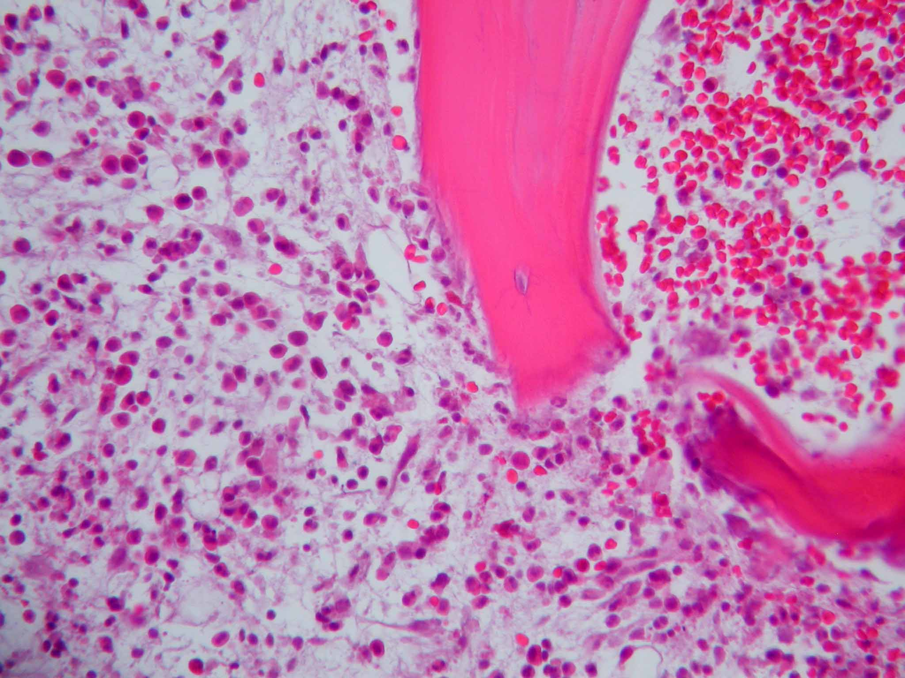
Case 5: Operative Pathology
Source: sacroiliac biopsy
Stain: H+E
Findings: neutrophil and plasma cell infiltration next to bony spicules, consistent with acute osteomyelitis
Photo credit: St. Joseph Mercy Health Systems
46
Notes:
Pathology findings from sacroilliac biospy included neutrophil and plasma cell infiltration next to bony spicules, consistent with acute osteomyelitis

Slide 47
Case 5: Sacroiliac Osteomyelitis
Operative treatment:
Procedure: incision and drainage
Intraoperative findings: small amount of purulent fluid
Pathology: acute osteomyelitis of right posterior ilium
Microbiology: Exserohilum confirmed
Medical treatment:
Inpatient: intravenous voriconazole
Discharge: 58 days after last injection
Symptoms: improved
Outpatient treatment: oral voriconazole
47
Notes:
Microbiology confirmed the presence of Exserohilum.
The patient was medically treated with intravenous voriconazole,
And the patient’s symptoms improved to the point where they were discharged 58 days after the last injection. She has continued on oral voriconazole as an outpatient.

Slide 48
Case 5: Sacroiliac Osteomyelitis — Summary
Diagnosis:
Potential complications from contaminated sacroiliac injections
Low MRI threshold in patients with contaminated sacroiliac injections
Treatment:
Unclear criteria for surgical intervention
48
Notes:
To summarize this case:
Remember that:
-Sacroiliac osteomyelitis is a potential complication of contaminated sacroiliac injections
-therefore you should Maintain a low threshold for MRI in patients exposed to contaminated sacroiliac injections
Also:
-the criteria for surgical intervention on sacroiliac osteomyelitis are not clear

Slide 49
Conclusions
Parameningeal infections, epidural abscess, osteomyelitis with discitis, and sacroiliac osteomyelitis are potential complications of contaminated methylprednisolone injections
Proactive outreach may identify patients earlier in their course
Maintain low threshold to order MRI with and without contrast at the spinal or paraspinal injection site in patients with persistent, worse, or new symptoms
Early surgical consultation essential for management of spinal and paraspinal infections
Optimal duration of medical treatment not yet known
49
Notes:
In conclusion:
Parameningeal infections, epidural abscess, osteomyelitis with discitis, and sacroiliac osteomyelitis are potential complications of contaminated methylprednisolone injections,
Proactive outreach may identify patients earlier in their course
Therefore you should maintain low threshold to order MRI with and without contrast at the spinal or paraspinal injection site in patients with persistent, worse, or new symptoms
Early surgical consultation is essential for management of spinal or paraspinal infections, and finally
The Optimal duration (and selection) of medical treatment for these infections is not yet known

Slide 50
Acknowledgements
Centers for Disease Control and Prevention
Mycotic Diseases Branch
Tom Chiller, MD MPH
Monika Roy, MD
Division of Healthcare Quality Promotion
John Jernigan, MD
Alice Guh, MD MPH
Raymund Dantes, MD MPH
St. Joseph Mercy Health Systems
Ann Arbor
Paul Valenstein, MD
50
Notes:
I would like to acknowledge the following persons for their contributions

Slide 51
Thank You
For more information please contact Centers for Disease Control and Prevention
1600 Clifton Road NE, Atlanta, GA 30333
Telephone: 1-800-CDC-INFO (232-4636)/TTY: 1-888-232-6348
E-mail: cdcinfo@cdc.gov Web: http://www.cdc.gov
The findings and conclusions in this report are those of the authors and do not necessarily represent the official position of the Centers for Disease Control and Prevention.
National Center for Emerging and Zoonotic Infectious Diseases
Division of Foodborne, Waterborne, and Environmental Diseases

